Slide 1



Wind Turbine Ground Vibration Simulator and Sensor
Project Kickoff

Slide 2



Agenda
Introductions
Background
Scope
Plan
Collaboration
Questions
Next Steps

Slide 3
Introductions

Slide 4

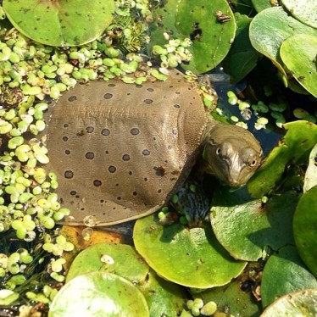
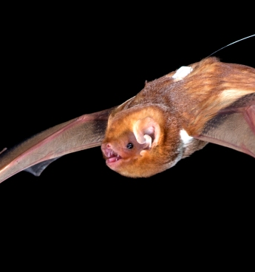
Background
The Davy Lab
Wind Turbine Project
Carleton lab conducting ecological conservation research for local and endangered species of bats, reptiles and amphibians.
Wind turbines generate low frequency (<1Hz – 50Hz) vibrations in surrounding ground.
Includes:
Turtle egg incubator built into ‘shake table’ to simulate ground vibrations
Sensors to be placed in wild turtle nests to measure ground vibrations

Slide 5


Scope
2 Students (Current)
3-4 Students
Vibration simulating incubator
Vibration sensor for use in simulation
Environment sensors
User interface for simulation control
Tasks for 2 students
Sensor for field use
Advanced user interface for simulator and sensor
Data visualization
Notes:
Scope will be different depending on # of students
For field sensor -> This may be more difficult than previously expected. From research, most groups that have done similar testing use buried post sensors. This may be expensive to develop. More research needs to be done on what goes in the post for sensing.
We have sent out emails to some DOE profs to see if any know students looking for a project
Discuss what we heard from DOE profs, that a DOE prof would need to supervise an ELEC student
A SYSC student interested in hardware could still be okay

Slide 6

Plan
Task | Begin | Draft | Completed
Research | Summer | - | Sept. 30
Proposal | Sept. 7 | Sept. 30 | Oct. 21
Hardware & Software Designs | Sept. 7 | Oct. 8 | Oct. 21
Finalize Part Orders | - | - | Sept. 30
Test Plan | Oct. 31 | - | Dec. 10
Development – Software & Hardware | Oct. 21 | - | Feb. 15
Progress Report | Nov. 1 | Nov. 18 | Dec. 9
Oral Presentations | Jan. 9 | Form – Dec. 9 | Jan. 23 - 27
Integration Testing | Feb. 15 | - | Feb. 28
Acceptance Testing | Feb. 28 | - | March 10
Poster Fair | March 1 | - | March 17
Final Report and Video | Jan. 15 | 1st - Feb. 17 2nd – March 24 | April 12

Slide 7
Collaboration
Engineering Team
Davy Lab Team
Weekly progress meetings with supervisors
Supervisors to be contacted for issues related to deadlines/implementation
Provides research goals
To decide – how often would the lab like progress updates? (Bi-Weekly?)
Lab members available for consultation on Discord and/or MS Teams
Tools:
Discord an option for non-urgent informal communication
MS Teams site for non-urgent communications
All documents will be saved on Teams site for collaboration
Notes:
Involves:
What can the lab do to help us along the way
Collaborative tools (Discord for informal, Teams for formal, Team site for keeping documents)
How often to meet with lab vs profs
How much say does Dr. Davy want on things such as proposal?
What to do in case of issues.
How are we going to do part ordering

Slide 8
Questions?

Slide 9
Next Steps
Looking for students
Wrap up research phase
Begin design phase & proposal writing
Create schedule for meetings (with supervisors and lab)
Notes:
What comes next…
Next meetings?
Ordering parts?
Looking for another student?

Slide 10

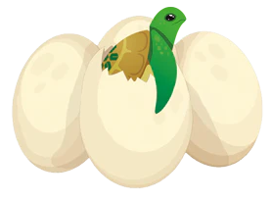


Slide 11
